Slide 1


Faculty of Engineering
American International University-Bangladesh(AIUB)
INTRODUCTION TO ELECTRICAL CIRCUITS LAB
Course Instructor: Md Sajid Hossain
Group: 8, Sec: O
Name | Student ID
Faysal Taher Sani | 22-47586-2
2.MD. Mehedi Hasan Abir | 23-50939-1
3.Fahad Hassan Fahim | 23-50940-1
4.Mahabub Hayath Mashuk | 23-50966-1
5.Nafiur Rahman Nirob 6.Saidur Rahman | 23-50991-1 23-51985-2

Slide 2

Tittle of the project
Charging &
Discharging of
capacitor for an RC circuit.

Slide 3

Outline of the Presentation
01
Objectives
02
Introduction
03
Equipment
04
Working Method
05
Description of the Work
06
Conclusion

Slide 4

Objectives
The main objective of this project is to construct the charging and discharging of a capacitor for an RC circuit & to gain knowledge about how a charging and discharging capacitor works in an RC circuit.

Slide 5


What is Charging and Discharging of capacitor for an RC circuit?
Introduction
Charging and discharging of a capacitor in an RC circuit is a fundamental process in electronics. In an RC circuit, a capacitor is connected in series with a resistor. This configuration allows for the controlled flow of current and the gradual buildup or release of charge on the capacitor.

Slide 6

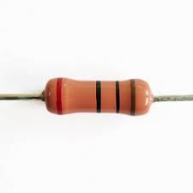
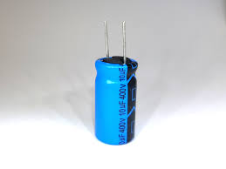
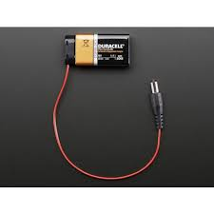
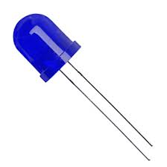
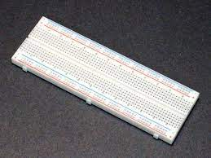
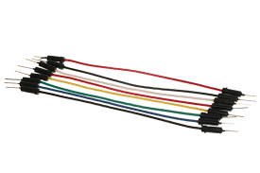
Equipment
Components, which we used for making the project.
Resistor
Capacitor
DC Power Voltage
Blue LED Light
Breadboard
Connecting Wire

Slide 7

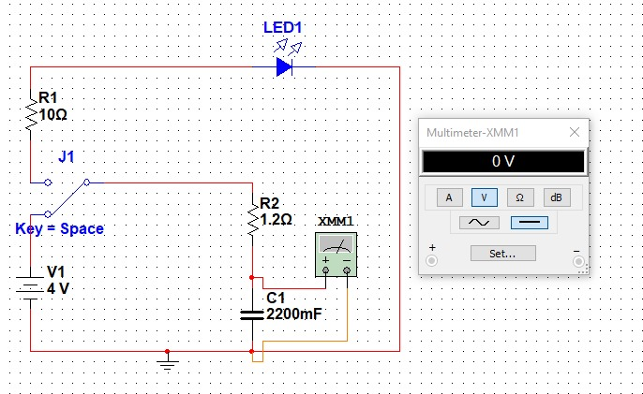
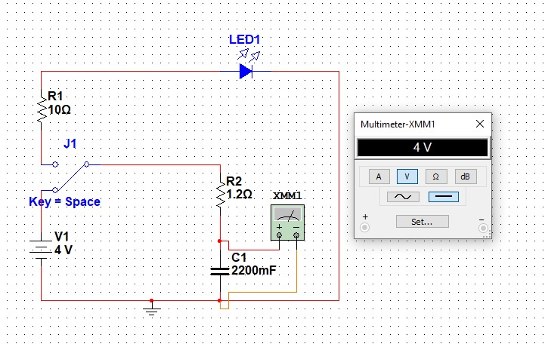
Working Method
Charging a Capacitor:
Setup: Connect a capacitor, a voltage source (such as a battery), and a resistor in series. The resistor limits the current flow during the charging process.
Initial State: At the beginning, the capacitor is uncharged, and its voltage across the terminals is 0V.
Charging Process: When the voltage source is connected to the circuit, current flows from the source through the resistor and into the capacitor. The capacitor starts accumulating charge, and its voltage gradually increases.
Approaching Full Charge: As time progresses, the voltage across the capacitor approaches the source voltage. However, it never quite reaches it, according to the exponential charging curve.
Full Charge: In an ideal case, the capacitor eventually becomes fully charged, and the voltage across it equals the source voltage.

Slide 8

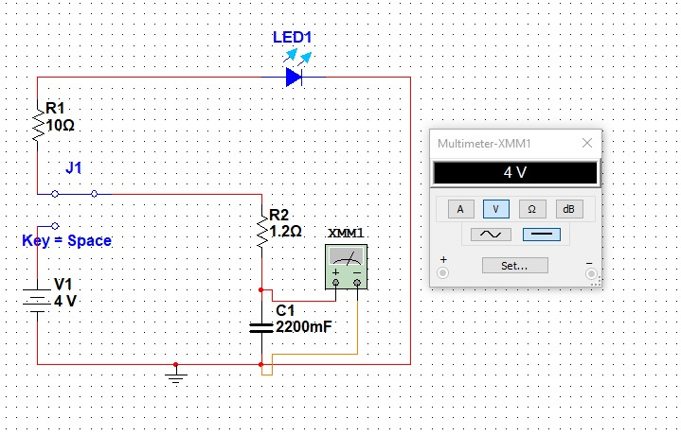
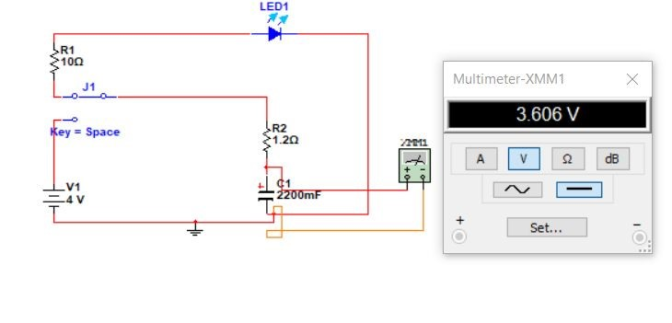
Working Method
Discharging a Capacitor:
Setup: Now, disconnect the voltage source and connect the charged capacitor to a resistor in a closed circuit.
Initial State: The capacitor is fully charged, and its voltage across the terminals matches the voltage of the source in the charging process.
Discharging Process: When the circuit is closed, current flows from the capacitor through the resistor. However, unlike during charging, this time the current is decreasing the stored charge on the capacitor.
Approaching Zero Voltage: As time progresses, the voltage across the capacitor approaches zero, but it never quite reaches zero, following an exponential decay curve.
Fully Discharge: In an ideal case, the capacitor's voltage eventually becomes negligible, and the capacitor is considered fully discharged.

Slide 9

Description of the Work

Slide 10

Calculation:
Charging Mode:
τ = (R x C)
= 1.2×2200mF
= 1 .2 × 2200 × 10⁻³
= 2.64 sec.
Full Charging;
5 𝑟=5 × 2.64=13.2Sec
Discharging Mode:
𝑟¯= (11.2 + 1 ) ×2200mF× 10⁻³
=24.64 Sec
Full Discharging;
5 𝑟¯=5 × 24.64=123.2Sec

Slide 11
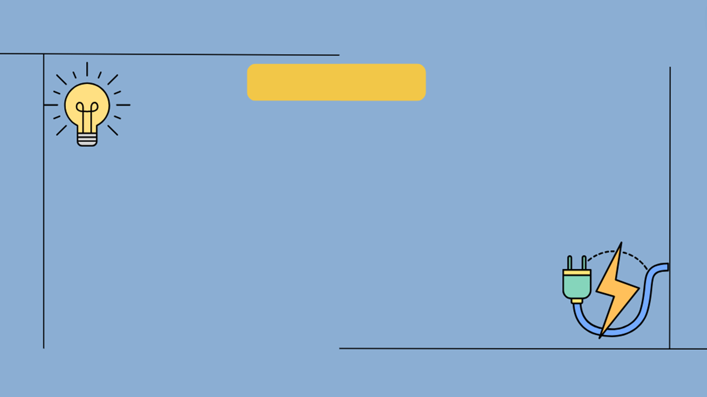
Conclusion
The charging and discharging of a capacitor in an RC circuit experiment demonstrates the time-dependent behavior of the circuit. During charging, the capacitor voltage increases exponentially, approaching the source voltage. During discharging, the capacitor voltage decreases exponentially. The time constant (τ = R * C)=2.64 s determines the rate of change. This experiment confirms the relationship between time, resistance, and capacitance in an RC circuit.

Slide 12


